Slide 1

LeafO3
Mohamed Khalil Ait Brahim
Saad Taame
Omar Bougamza

Slide 2
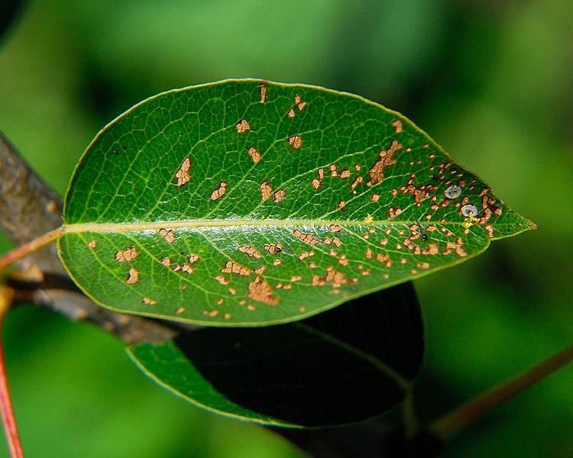
Ozone Damaged Leaf

Slide 3
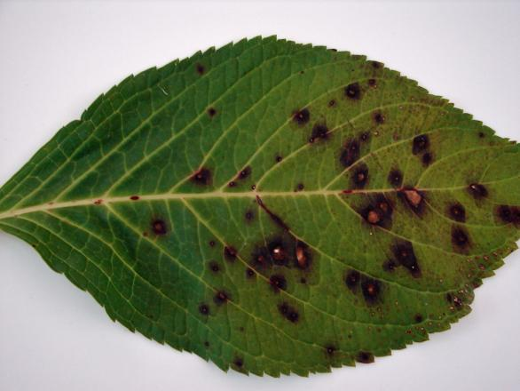
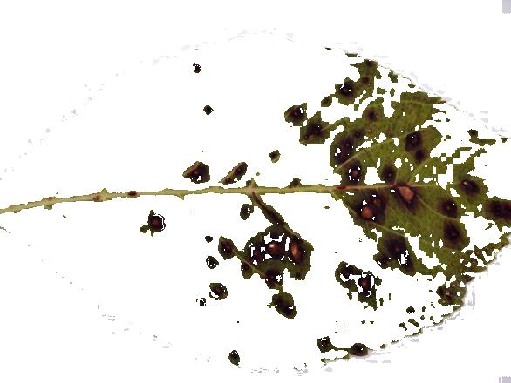
Case
INPUT
OUTPUT

Slide 4
LeafO3
What we did ☺

Slide 5
LeafO3 Features
Guide a user through a protocol for taking a single leaf image;
Acquire a picture of a leaf through a smartphone camera;
Use the colors in the picture to calculate the area of the leaf and;
Determine the fraction of the leaf that has been injured by ozone.

Slide 6
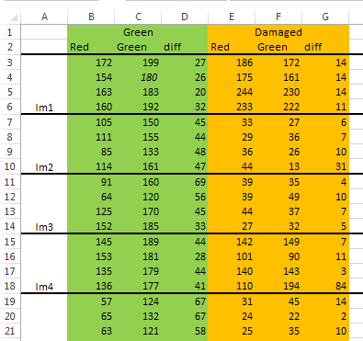
Data Set

Slide 7
Algorithm
Study pictures of leaf samples.
Background pixels:
abs(r-g) < 15 AND abs(b-r) < 15.
High green/red contrast:
Healthy pixel: green channel value > red channel value.
Low green/red contrast:
Healthy pixel: ABS(red channel value - green channel value) >
Classifying Pixels

Slide 8
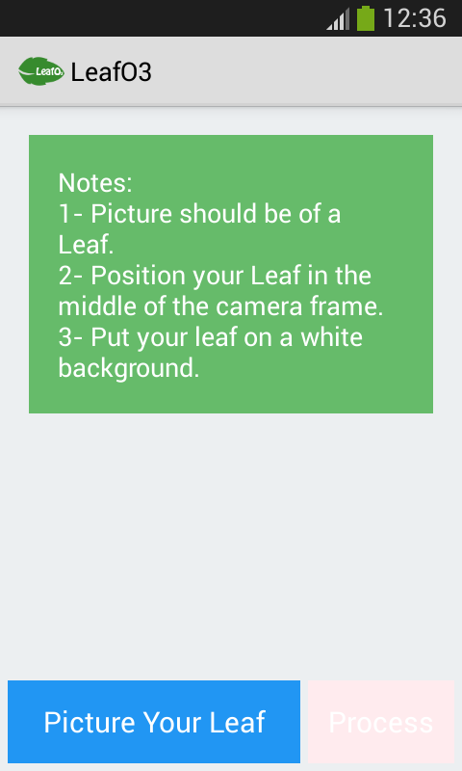
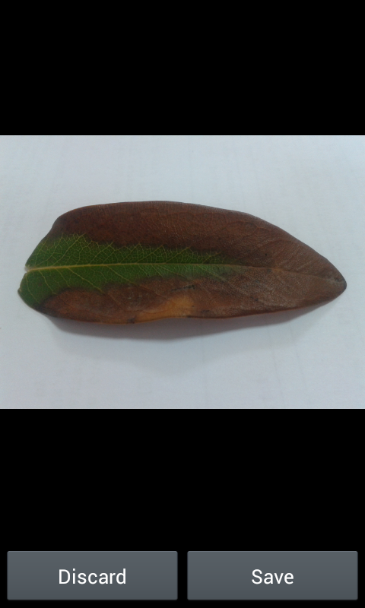
Taking a picture

Slide 9
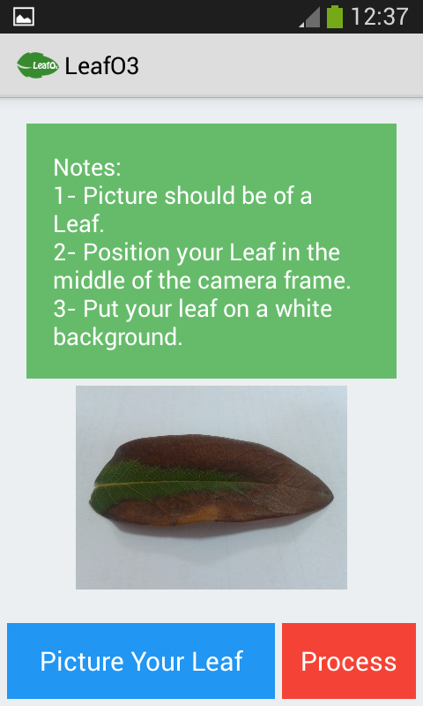
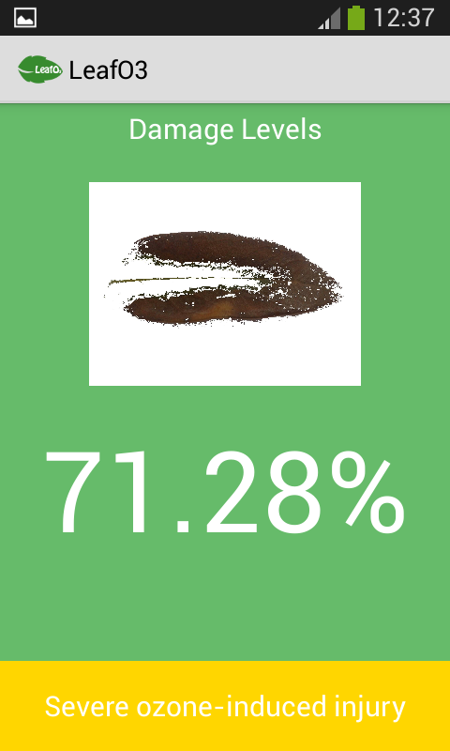
Leaf Analysis

Slide 10
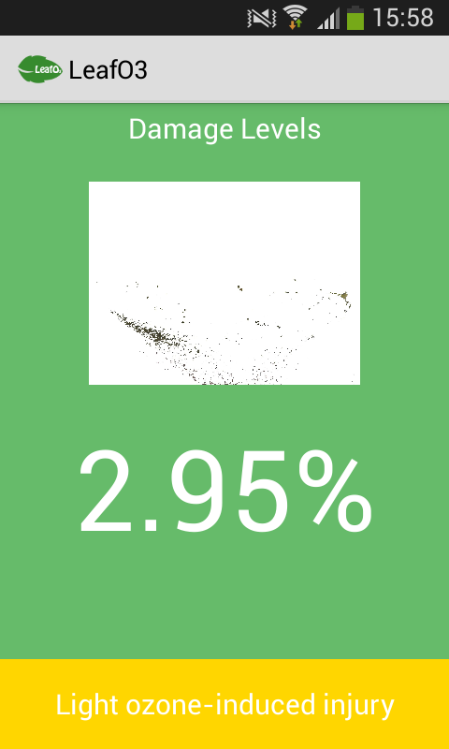
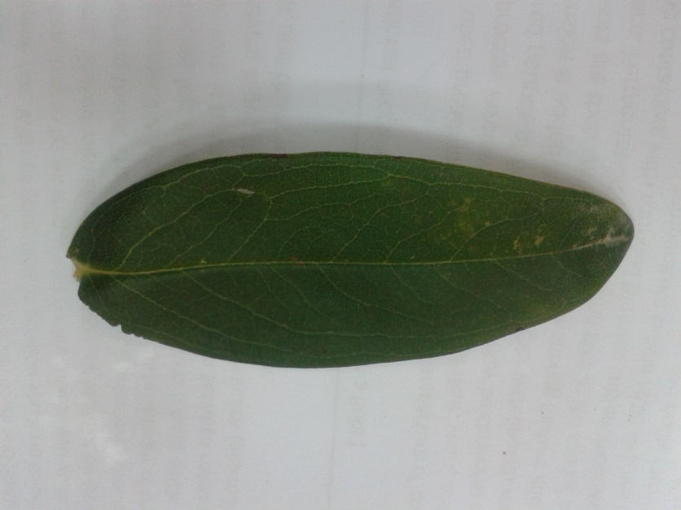
Leaf 1

Slide 11
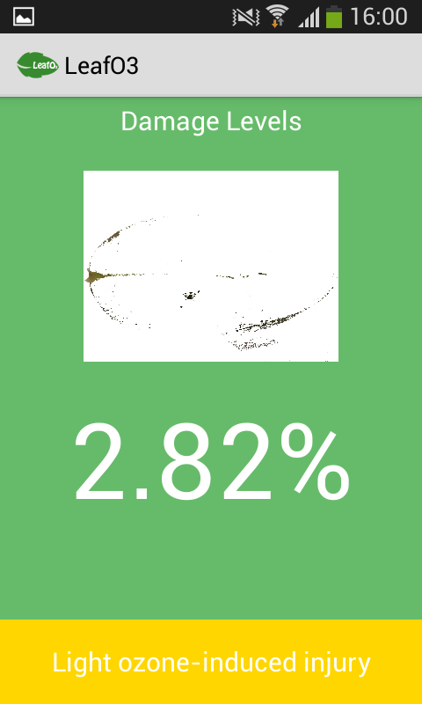
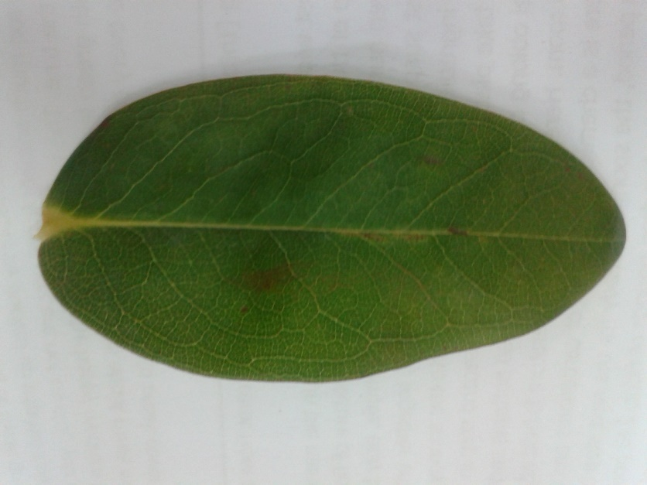
Leaf 2

Slide 12
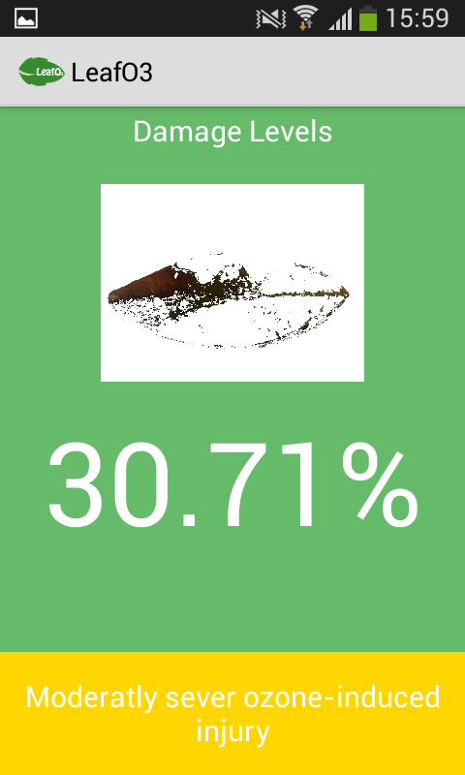
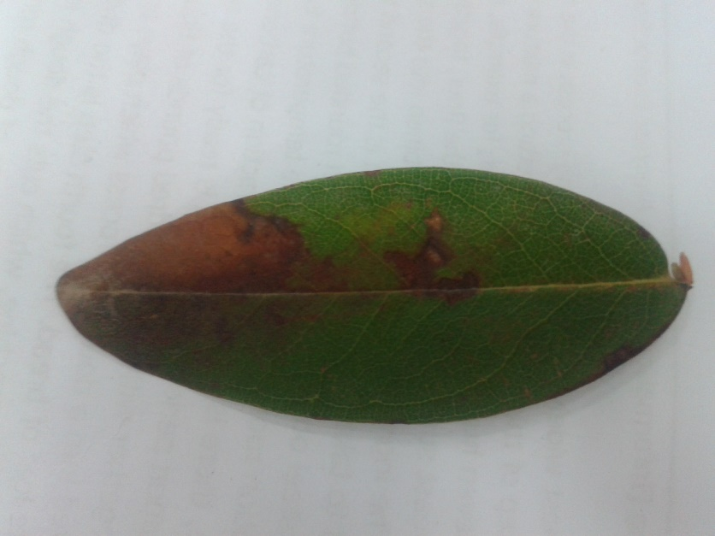
Leaf 3

Slide 13
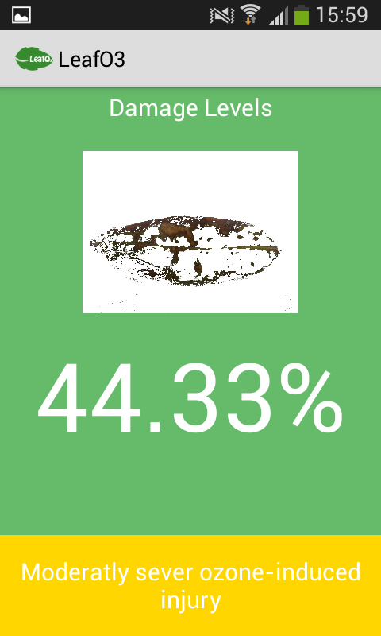
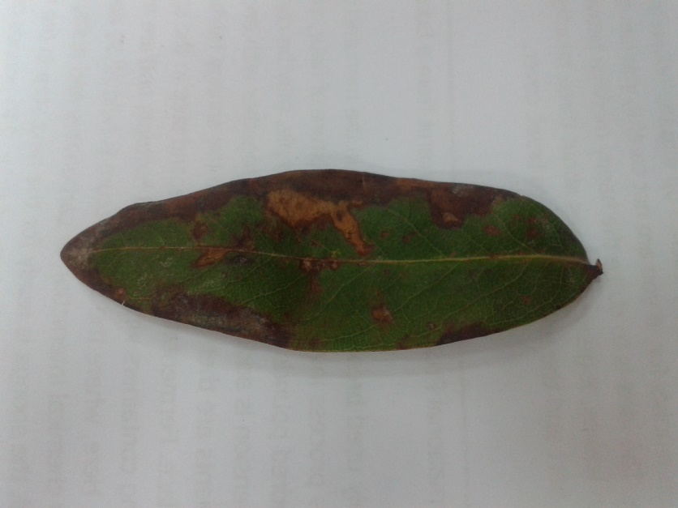
Leaf 4

Slide 14
Moment of Truth ☺

